Slide 1
Python Classes and Objects
Python is an object oriented programming language.
Almost everything in Python is an object, with its properties and methods.
A class is a blueprint of creating an object (like a Constructor).
The keyword to remember is “class” itself.
# For Ex – Creating a class with Name MyClass
class MyClass :
x = 5
# Print created class
print(MyClass)
output : <class '__main__.MyClass'>

Slide 2
Creating an Object
# Create an object named p1, and print the value of x
class MyClass:
x = 5
p1 = MyClass() # Object creation using constructor
# Accessing the property of an Object using the dot (.) notation.
print(p1.x)
Output : 5
Define an Empty class
A class body can’t be empty , if we have nothing to define then need to use pass statement to ignore error message
# Defining an empty class
class Person :
pass

Slide 3
The __init__() Function and Classes
All classes have a function called __init__()
It is always executed when an object is being created
We can use it to assign values to object properties &
To perform other necessary operations required at the time of object creation
# Create a class named Person, and use the __init__() function to assign values for name and age:
class Person: def __init__(self, name, age): self.name = name self.age = age
p1 = Person("John", 36) print(p1.name) print(p1.age)
output :
John 36

Slide 4
A word about ‘self’
class Person:
def __init__(self, name, age):
self.name = name
self.age = age
p1 = Person("John", 36)
print(p1.name)
print(p1.age)
Simply stated, self refers to an instance itself.
For now, just know that when we want to refer to instance variables in the class, we need to add self in front of the variable names.
In addition, most methods in a class have self as the first parameter.

Slide 5
Object Methods
Class can contain methods for objects
# For Ex – Defining a method that print a message on its call by object
class Person: def __init__(self, name, age): self.name = name self.age = age
def greeting(self): print("Hello my name is " + self.name)
p1 = Person("John", 36) p1.greeting()
output : Hello my name is John
Note : The self parameter is a reference to the object of the class, and is used to access properties of the object
Note : First parameter of a method always refer to the current object , no matter what its name.

Slide 6
Function and Method
Function is usually understood as a standalone block of code.
>>> m = lambda a, b: a * b
>>> m(5, 5)
25
>>> m
<function <lambda> at 0x7f69cd84d280>
>>>
Method is understood as a funtion associated with a class or it’s object.

Slide 7
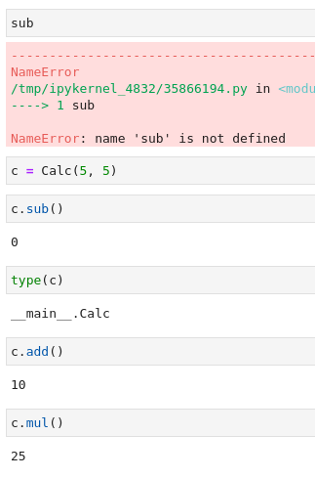
class Calc:
def __init__(self, a, b):
self.a = a
self.b = b
def add(self):
return self.a + self.b
def mul(self):
return self.a * self.b
def sub(self):
return self.a - self.b

Slide 8
Modify and Deleting Object Properties
# For Ex – Modify the age of Object p1 to 40 :
class Person:
def __init__(self, name, age):
self.name = name
self.age = age
def myfunc(self):
print("Hello my name is " + self.name)
p1 = Person("John", 36)
p1.age = 40 # Modify the age for object p1
del p1.name # Deleting the name property for object p1 by using del keyword
print(p1.age) # Output will be : 40
print(p1.name) # Output will be : AttributeError: 'Person' object has no attribute ‘name'

Slide 9
Deleting an Object
An object can be deleted by using del key word as well
# For Ex - Delete the p1 object
class Person:
def __init__(self, name, age):
self.name = name
self.age = age
def myfunc(self):
print("Hello my name is " + self.name)
p1 = Person("John", 36)
del p1
print(p1)
output :
NameError: 'p1' is not defined

